Slide 1
Malignant Hyperthermia
Keeping Our Patients Safe
By
Ginger VanDenBerg

Slide 2
Malignant Hyperthermia
Learning Objectives
At the end of the learning module the participant will be able to:
Define Malignant Hyperthermia
Identify pathophysiology changes related to Malignant Hyperthermia
List risk factors and triggering agents related to Malignant Hyperthermia
Describe signs & symptoms of a Malignant Hyperthermia crisis
Prioritize specific supplies and treatment for Malignant Hyperthermia
Define the role of MHAUS

Slide 3
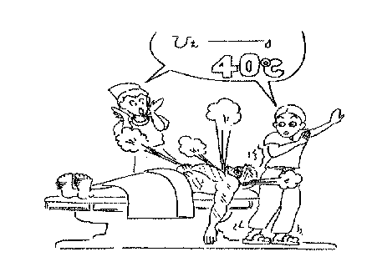
Malignant Hyperthermia
What is it?
A rare genetic condition effecting the skeletal muscular cells, characterized by an abnormal hypermetabolic state brought on by certain anesthetic gases and/or succinylcholine.

Slide 4
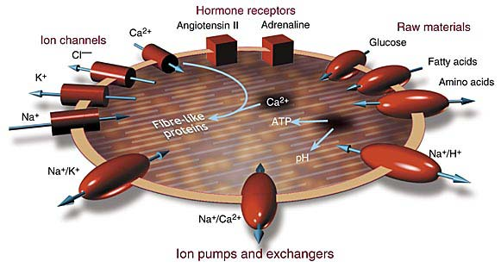
Malignant Hyperthermia
Pathophysiology
(What is happening within the cell?)
The primary defect resides in the skeletal muscle system at the level of calcium release from the sarcoplastic reticlulum of the muscle cell.
Triggering agents interfere with the muscle cells ability to control intracellular Ca++.
There is an excess release of Ca++ and interference with Ca++ returning to storage, creating a high intracellular Ca++ level.
The high intracellular Ca++ level leads to continuous contractures of the skeletal muscles. Leading to cellular exhaustion and death

Slide 5
Malignant Hyperthermia
Pathophysiology
(What is happening within the body?)
O2 Consumption
Heat Production
Use of ATP
Release of CO2
Release of Lactic Acid
These actions cause a disruption of the cell membrane integrity which allows K+, Mg++, phosphate, cellular enzymes and myoglobin to leak into the extracellular fluids.

Slide 6
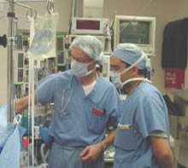
Malignant Hyperthermia
Triggering Agents
Succinylcholine
A depolarizing
muscle relaxant
with no reversal
Anesthesia Gases
Halothane
Isoflurane
Enflurane
Sevoflurane
Desflurane

Slide 7
Check in question
Malignant Hyperthermia is a rare genetic condition that is triggered by certain anesthetic agents such as, succinylocholine or anesthetic gases.
True or False
During a Malignant Hyperthermia crisis, triggering agents interfere with the muscle cells ability to control calcium ions (both release & re-uptake).
True or False

Slide 8
Check in question
Malignant Hyperthermia is a rare genetic condition that is triggered by certain anesthetic agents such as, succinylocholine or anesthetic gases.
True
During a Malignant Hyperthermia crisis, triggering agents interfere with the muscle cells ability to control calcium ions (both release & re-uptake).
True

Slide 9
Malignant Hyperthermia
Who is at Risk
MH is an autosomal dominant inherited disorder. The child of a MH parent has a 50% risk of also being MH susceptible.
Males develop reactions more frequently than females
People under 18 years of age have the highest incidence of MH.
MH is associated with neuromuscular disorders such as: Central Core Disease, Duchenne muscular dystrophy, myopathies, periodic paralysis, and episodes of heat exhaustion
Fact: Wisconsin, Nebraska, West Virginia, and Michigan have higher reported MH incidences than other states.

Slide 10
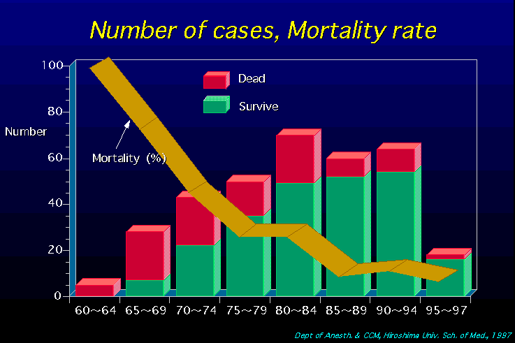
Malignant Hyperthermia
Statistics
The Malignant Hyperthermia Association of the United States (MHAUS) reports that MH occurs as frequently as 1 : 5,000 patients.
The MH mortality rate has been reduced from as high as 70% to < 5% with the treatment of Dantrolene
Fact: MHAUS was formed to provide a central resource center to collect data and provide education/information to the public

Slide 11
Check in Questions
Males develop symptoms more frequently than females.
True or False
Michigan is one of four states that has a higher report incidences of MH.
True or False
It is estimated that MH occurs in 1 : 50,000 patients.
True or False

Slide 12
Check in Questions
Males develop symptoms more frequently than females.
True
Michigan is one of four states that has a higher report incidences of MH.
True
It is estimated that MH occurs in 1 : 50,000 patients.
False

Slide 13
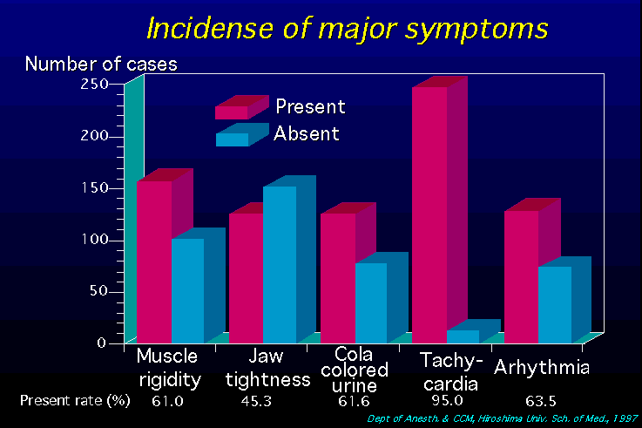
Malignant Hyperthermia
Signs & Symptoms
Unexplained Tachycardia-often the first sign (often mistaken for “light anesthesia”)
Masseter muscle rigidity-that is severe, sustained, and interferes with intubation
Hypercarbia-resulting in elevated end tidal CO2 and O2 consumption
Hyperthermia-Defined in MH as a temp > 40*, often a late sign, body temp can rise as fast as 1* every 5 minutes..

Slide 14
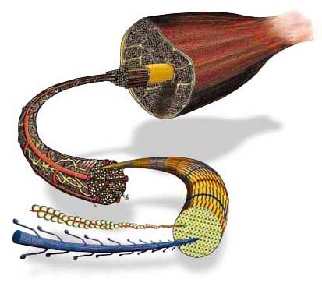
Malignant Hyperthermia
Signs & Symptoms
Skin changes- generalized red flushing and/or mottling. Diaphoresis may also be present.
Rhabdomyolysis- skeletal muscle is damaged and intracellular contents begin to leak into the bloodstream.
Myoglobinuria-becomes evident as a result of muscle tissue breakdown (turning urine a dark red or brown).
Renal Function- maybe altered. Due to leakage of muscle contents and filtering by the kidneys.

Slide 15
Check in Questions
Unexplained tachycardia is often the first sign of MH and is frequently mistaken for “light anesthesia”.
True or False
Hyperthermia related to MH is defined as a body temp > 40*C and is consider a late sign.
True or False

Slide 16
Check in Questions
Unexplained tachycardia is often the first sign of MH and is frequently mistaken for “light anesthesia”.
True
Hyperthermia related to MH is defined as a body temp > 40*C and is consider a late sign.
True

Slide 17
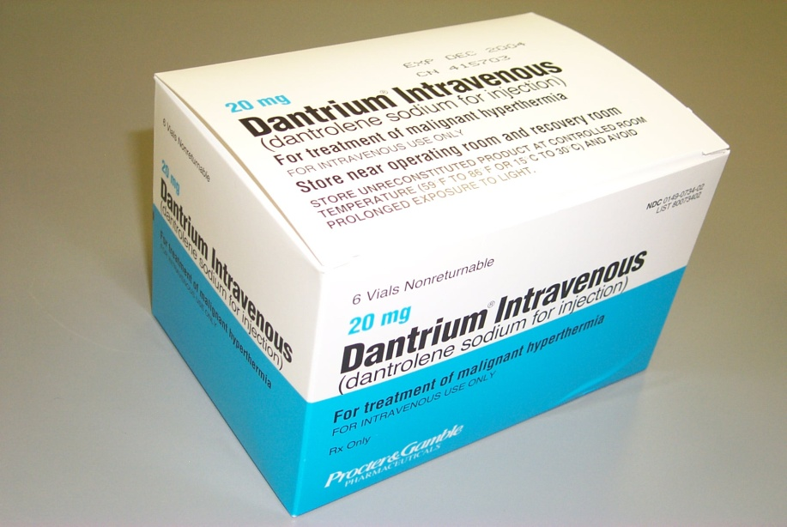
Malignant Hyperthermia
Treatment
Despite more than 25 years of research, Dantrolene Sodium (Dantrium) is the only clinically available agent for the treatment of MH.
Dantrolene is supplied as a lyophilized powder that contains 20mg dantrolene sodium and 3,000mg of mannitol
Fact: It may take from 2-4 licensed personnel to reconstitute the required of dantrolene for rapid administration.

Slide 18
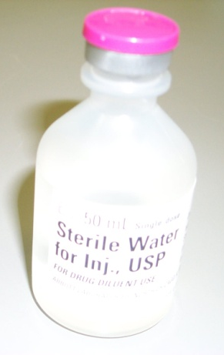
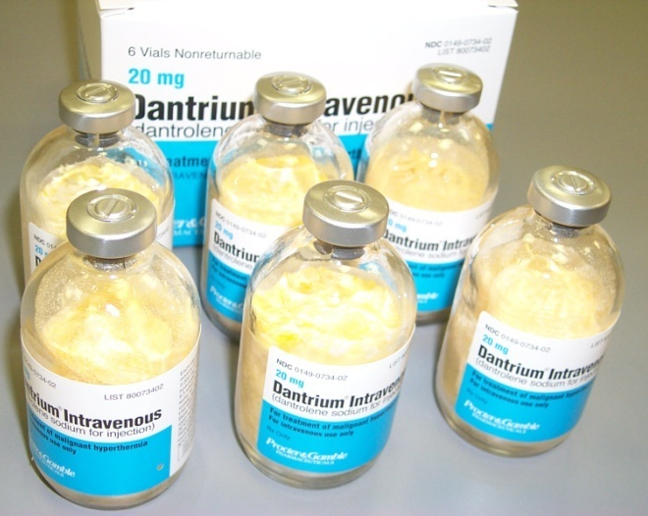
Malignant Hyperthermia
Dantrolene Sodium Handling
-Reconstitute each vial by adding 60 ml of preservative-free water. DO NOT USE bacteriostatic water.
-Shake bottle vigorously until solution is clear
-Protect from light
-Use within 6 hours after reconstitution.
Fact: The liver metabolizes dantrolene, CONTRAINDICATED with active hepatic disease.

Slide 19
Malignant Hyperthemia
Dantrolene Sodium
(How much is needed?)
8 to 10mg/kg of dantrolene sodium is needed to treat a patient in acute MH crisis
(e.g. 50 vials must be available to treat a person who weighs 100-110 kg)
Repeat with 2.5mg/kg doses up to 4 doses.
Delivery is rapid, continuous IV push

Slide 20
Malignant Hyperthermia
Additional Medication Management
In order to treat symptoms due to cellular leakage & death
Insulin - 0.15 units regular/kg
Glucose – 1ml/kg D50W
Calcium Chloride – 2-5mg/kg
Sodium Bicarbonate - 1-2mEg/kg
Furosemide (lasix) – 0.5-1mg/kg
Lidocaine/Amiodarone
Procainamide
Fact: DO NOT USE CALCIUM CHANNEL BLOCKERS
Treat Metabolic Acidosis
Improve Renal Function
Treatment of Arrthymias

Slide 21
Check in question
When reconstituting Dantrolene you should use which of the following?
60cc Preservative-Free Water
60cc Bacteriostatic Water
Each vial of Dantrolene contains 20mgs of Dantrolene?
True or False

Slide 22
Check in question
When reconstituting Dantrolene you should use which of the following?
60cc Preservative-Free Water
Each vial of Dantrolene contains 20mgs of Dantrolene?
True

Slide 23

Preoperative Nursing
Role
Assess patient/family history related to MH susceptibility
? Has anyone ever told you that you or a family member had a problem with anesthesia?
? Have you or a family member experienced a high fever while under anesthesia?
Notifies Anesthesia and OR nurse if patient concerns related to MH arise.

Slide 24
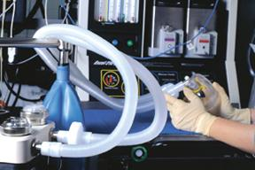
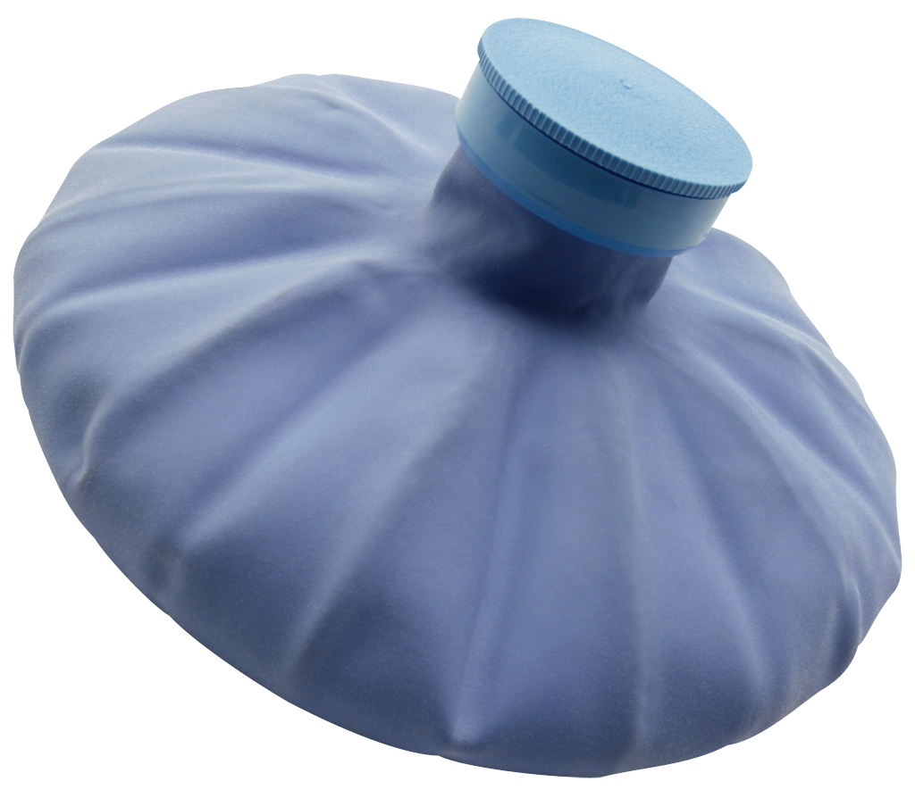
Operating Room Nursing
Role
Collaboration with Anesthesia is imperative
Seek extra licensed personnel to mix dantrolene
Assemble ice packs & place at axilla and groin areas
Dispense cold saline for body cavity irrigation
Insert 3 way foley catheter for cold irrigation and urine output
Assist with central line placement

Slide 25
Post Recovery Nursing
Role
Continue to deliver dantrolene 1mg/kg IV every 4 to 8 hours (per Anes order)
Monitor core temp and continuing cooling until temp is 38*C (100.4* F)
Monitor vital signs, urine output, obtain serum studies, monitor for arrhythmias
Extubated patients will have difficulty swallowing, weak grip strength and leg movement (educate patient)
Monitor for MH recurrence (can occur within the first 24 hours)
Recommendation: Patient should be monitored in a critical care unit for a minimum of 36 hours.

Slide 26
Check in Question
Should the Preoperative nurse alert Anesthesia if a patient is suspected of being susceptible or having a history of MH.
True or False
Should the Postoperative nurse monitor for recurrence of MH, especially within the first 24 hours?
True or False

Slide 27
Check in Question
Should the Preoperative nurse alert Anesthesia if a patient is suspected of being susceptible or having a history of MH.
True
Should the Postoperative nurse monitor for recurrence of MH, especially within the first 24 hours?
True

Slide 28
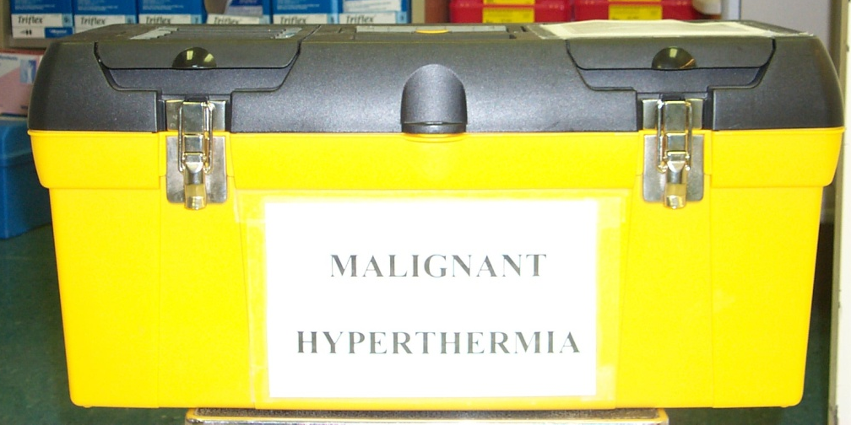
Malignant Hyperthermia
Preparedness at Genesys
Here at Genesys Regional Medical Center there are 2 available Malignant Hyperthermia tackle boxes.
1-box is kept on the 3rd floor operating room located within the anesthesia workroom.
1- box is kept on the 1st floor labor & delivery operating rooms within the anesthesia workroom

Slide 29
Malignant Hyperthermia
Preparedness at Genesys
The Malignant Hyperthermia Tackle Boxes contain the following:
24 vials of Dantrolene
25 vials of Preservative-free Sterile Water
5 amps of Sodium Bicarbonate
2 amps of Dextrose 50%
2 amps of Procainamide
2 amps of Calcium Chloride
2 amps of 2% Lidocaine
Assorted Needles, Syringes, Filters, & NG Tube

Slide 30
MHAUS contact Information
The MHAUS goal is to educate the public and offer support to patients and their relatives. Patients and their families should be given information about MHAUS including:
-Website: www.mhaus.org
-Phone number: (607)674-7901
-Email: info@mhaus.org

Slide 31
Summary
MH is an autosomal dominant inherited disorder.
More than 50% of MH susceptible people are not aware of their condition.
The most frequent triggering agents are succinylcholine & most anesthetic gases.
The triggering agents interfere with skeletal muscle cell’s ability to regulate the ca++ ions.
Dantrolene is the only treatment available for MH
MHAUS is an organization that provides MH education to patients, family members, & health care providers.

Slide 32
References
Association of periOperative Registered Nurse (AORN) (2011), Perioperative standards and recommended practices. Denver, CO: AORN Publications
Larach, M. G., Dirkesen, S., Belani, K. et.al. (2012). Creation of a guide for transfer of the care of the malignant hyperthermia patient. www.anesthesia-analgesia.org/content/114/1/94?related-urls=yes&legid=anesthanalg;114/1/94.
Malignant Hyperthermia Association of the United States (MHAUS) (2011). Healthcare professional. www.mhaus.org/healthcare-professionals/#.UBqRyJirU21.
Permission granted from MHAUS to use and distributed contact information

Slide 33
MH Leaning Assessment
Case Study
A 16 year old male scheduled to have his appendix out, arrives in the preoperative area. The preoperative nursing assessment reveals the patient denies ever having surgery and is unaware of family members ever having difficulty with anesthesia. However the patient does state he has been treated for heat exhaustion and does have periods of paralysis in his right leg
Name three (3) pieces of patient assessment data that should alert the nurse to the patient being at risk for MH.

Slide 34
Malignant Hyperthermia
Learning Module Quiz
Please Click Here To Be Redirected To The MH Quiz
Just a reminder this module is not part of nursing’s annual competency requirements
Thank you for your time and feedback!

